Slide 1
Effective Strategies for Violence Prevention and Promoting Psychological Health and Safety in Long Term Care Settings
Jess Selby and Teaghan Sampson
Notes:
Jess
Hello and welcome to Effective Strategies for Violence Prevention and Promoting Psychological Health and Safety in Long Term Care Settings
Jess: My name is Jess Selby
Teaghan: and my name is Teaghan Sampson
Jess: we’ll be your facilitators for this session, please ask questions and bring thoughts forward as we progress through the next hour ☺

Slide 2
Land Acknowledgement
We acknowledge and regret the historical injustices towards the Indigenous People of our nation, leading to generational disenfranchisement.
Recognizing the impact on our indigenous communities, we acknowledge the loss of women, children, community, family, language, and spirituality.
As an organization, we commit to embracing the reconciliation movement and learning from our past, honoring past and future generations, as well as the land and its original inhabitants.
Through education and acknowledgment, we aim to move forward by recognizing and appreciating the contributions and teachings of our Indigenous communities throughout history.
Notes:
Jess

Slide 3
Who are we
Manitoba Association for Safety in Healthcare (MASH) in Manitoba’s health care specific, industry-based safety program. We provide safety training, consulting services and Safe Work Certification for all healthcare workers and health care organizations. We are committed to working with our members to provide the safety and health resources they need to create a safe work environment for their employees.
Notes:
Jess

Slide 4
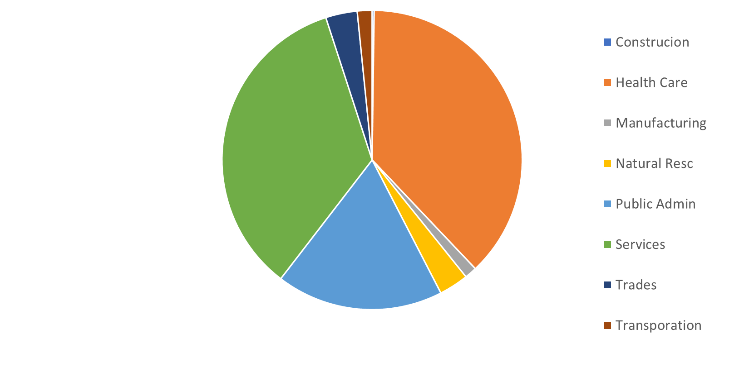
Assaults & Violent Acts by Industry 2023
Notes:
Jess
If we look at this chart what stands out?
Out of all industries, Health Care has the highest rate of violent acts in in 2023, based on the next slide we will show a significant increase in 2024.
We work in health care
We work with people…. and while we’re here because of the people, we also are dealing with high emotion, illness and in the case of all of you here today, an aging population that are dealing with the fear of aging, but also the changes in cognitive function over time
We have high instances of dementia, family members that can be scared and sometimes disagreeable, and sometimes you are working alone and need a plan to keep you safe.

Slide 5
WHY?
Data includes all organizations in MASH industry group
Year | Total claims | Total time loss | Total assaults | Time loss assault
2020 | 3995 | 2620 | 409 | 229
2021 | 4068 | 2641 | 443 | 265
2022 | 4386 | 3088 | 407 | 242
2023 | 3765 | 2427 | 456 | 284
2024 | 3835 | 2373 | 554 | 350
27% increase from 2022
Notes:
Jess
Claims information gathered from WCB as of
March 26, 2025
Why are we looking at violence prevention? What is the importance?
Claims information gathered from Compass (WCB) as of March 26, 2025
If we look at the data, we can see there is a steady increase in total assaults. From the years 22-24, there was a 27% increase in assaults on people in the health care field
These numbers aren’t decreasing in the foreseeable future, we need to look at these numbers and formulate a plan moving forward, looking at protection for the health care workers while providing care?

Slide 6
Overview
Understanding Violence Prevention
Psychological Health and the Importance in Long-Term Care Settings
Responsive Behavior Response Training
Notes:
Teaghan
This presentation is about prevention…..from understanding violence, the impact violence has on our psychological health, what responsive behavior is, how we can identify responsive behaviour and how to appropriately respond to those stressful situations.
Understanding Violence Prevention
What is Violence
Types of Violence
Responses to Violence
Psychological Health and the Importance in Long-Term Care Settings
Creating a Safer Environment
Recognizing and Overcoming Societal Barriers
Managing Personal Responses
Responsive Behavior Response Training
Fit for Duty
Identifying Responsive Behaviors
Practical Approaches and Intervention Strategies

Slide 7
Understanding Violence Prevention
  What is Violence:
  The attempted or actual exercise of physical force against a person;
  any threatening statement or behavior that gives a person reasonable cause to believe that physical force will be used against the person.
Violent Behaviors
Violent behavior is the most extreme manifestation of aggression, involving the use of physical force to injure, damage, or destroy.
Notes:
Teaghan
As per Legislation, Violence is (read slide)… and Violent behaviours are considered…
Violence is defined by the World Health Organization in the WRVH as “the intentional use of physical force or power, threatened or actual, against oneself, another person, or against a group or community, that either results in or has a high likelihood of resulting in injury, death, psychological harm, maldevelopment or deprivation
Violence: a glossary – PMC
violent behavior definition – Search
Types of gender-based violence - Gender Matters
Consider changing the definition of "What is Violence" to:
The attempted or actual exercise of physical force against a person; and
any threatening statement or behavior that gives a person reasonable cause to believe that physical force will be used against the person

Slide 8

Types of Violence
  Physical
  Verbal
  Psychological
  Domestic
  Harassment
  Sexual harassment
Notes:
Teaghan
Some examples:
Psychological: Blackmail, coercion and intimidation

Slide 9
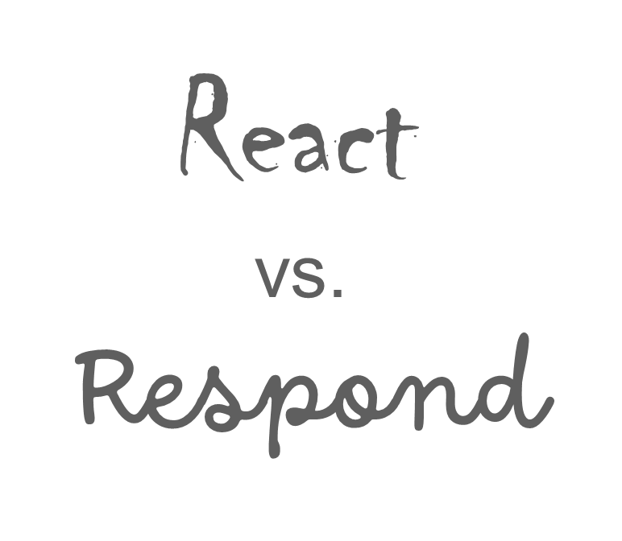
Response to Violence
Notes:
Teaghan
In an ideal world, we’d like to be prepared for these situations. Unlike preparing for a job, the only physical tool we’ll have with us will be ourselves. This starts with our knowledge, our training, being able to identify those risk factors promptly and understanding our roles, however, it also means we have to understand ourselves and how we behave under stressful situations.
There’s two different ways that we respond when in stressful situations; involuntarily or voluntarily.
When we talk about involuntary responses, I want you to think of the 5 different stress responses:
Fight – confronting the perceived threat head-on
Flight – escaping or avoiding the perceived threat
Freeze – becoming immobile or non-reactive
Fawn – appeasing or complying with (people pleasing)
Flop – completely collapsing (fainting) or disassociating from the situation
Every action brings an instinctual reaction.
Our natural instinct is to REACT to the situation where we become defensive to our surroundings. – this will be heavily dependent on how we respond to stress.
However it is more effective to RESPOND, this is where we take the time to assess our surroundings and respond to the behavior in a controlled and logical way
Responding to situations is much harder and requires adequate support and training – we need to retrain our minds to appropriately respond.

Slide 10
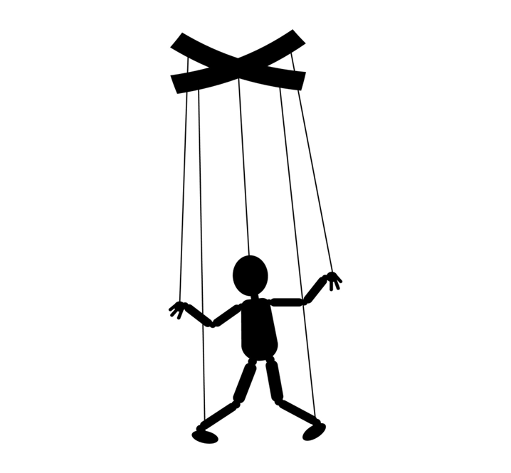
Response to violence
When you react, you are being controlled:
  Its typically quick and instinctive
  Automatic and driven by immediate feelings
  Involves emotionally charged behavior in the moment
  Without much consideration of consequences
Notes:
Teaghan
Our involuntary response is our NATURAL REACTION.
When we do the first thing that comes to our minds in an escalated situation, we’re operating from a place of emotion, thus reacting to the attitude (feelings) of the individual. This means we’re emotionally charged and we’re not considering the consequences of our actions.
How will what we say or do in this state impact the individual?
How will this negatively affect the situation?
We don’t consider those questions because we aren’t giving thought to our own actions. When we lose sight of how our actions will impact the situation, we lose control. When reacting to responsive behaviours, we are allowing the individual to control us as we are acting without thinking. For example, if they start yelling at us and we get defensive – they’re controlling our actions because we’re impulsively communicating with them.
Reacting to the attitude puts us at risk of further escalating the individual.
This will not lead to a good outcome.
Instead, we want to maintain some control over the situation, so we don’t further escalate the individual, therefore, we want to respond.

Slide 11

Response to Violence
When you respond you are handling the situation:
Focus on the behaviour not the attitude.
Thoughtful and deliberate, involves self control and assessing the situation.
Choosing the best course of action or response.
Considers potential outcome or effects.
Notes:
Teaghan
So, when we ask ourselves:
How will what we say or do in this state impact the individual?
How will this negatively affect the situation?
We force ourselves to become more aware of the situation and consider the potential consequences of our actions.
When we take a step back and think before acting, we’re able to separate the individual’s attitude (feelings) from their behaviour (actions). When we turn our focus onto their behaviour (actions), we’re able to logically respond to the situation by assessing a few key components; are their actions harmful to themselves, me, or others? Is there a need they are displaying that’s not being met? Are they showing me how I can help them?
By stopping to think before we act, we’re allowing ourselves to retrain our natural instincts of protecting ourselves (reacting), and we’re able to refocus on the goal: returning the individual to their baseline (a happy result). Reminding ourselves of this allows us to maintain our control of our self and logically assess the situation so we can choose the best course of action and consider the potential effects; If I don’t do x, what’s the worst that will happen? If I say this, will it help or make them more frustrated? If I do x, what is the consequence or benefit?
Responding to the behavior is the ultimate goal.
When we respond, we can empathize with the individual and de-escalate.
In order to appropriately respond to a situation we need to maintain self-control. In order to maintain self-control, we need to be aware of our triggers – when we understand our triggers, we can appropriately respond. Understanding our triggers depends on our psychological health and being aware of our inner feelings and mental health.

Slide 12

Psychological Safety and Health
A growing concern in healthcare:
  Staff shortages
  Heavy work loads
  Lack of time
  Lack of resources
These conditions can take a tole mentally and physically on staff.
Notes:
Jess
Outline the fallout and the benefits of implementing a program and how it will in turn decrease of positively impact the above
All of these concerns lead into each other.
Staff shortages lead to heavier work loads
Heavier work loads impact out time to care
Heavy work loads decreases the time availability of staff
The lack of resources can impact everyone in your workplace
And can cause:
Increase injuries,
Increase time off
Increase sick time
Which leads to burnout,
Fatigue
Mistakes

Slide 13
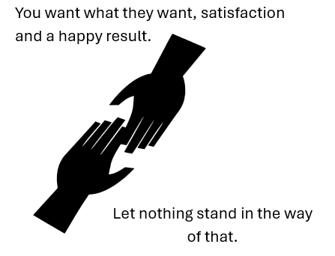
Positive Psychological Health and Safety
Decreases absenteeism and presenteeism
Improves morale
Improves productivity
Creates a sense of physical and psychological safety
Decrease in staff shortages will in turn give back time, balance workloads and give a sense of belonging or engagement.
Notes:
Jess
What are the benefits of a Psychological Health and safety program
Decrease absenteeism/presenteeism – have you ever sat in your car and cried before going into work….?
When we are in a workplace where we are part of something and we feel safe, we’re not overwhelmed,
and our engagement increases, our team gets stronger….we want to come to work!
When we are physically and mentally prepared, we are better able to support each other!
Improves moral - when people feel valued and safe they are more engaged we belong and feel like we’re part of something, we’re a community….and we want to support each other
Improves productivity – what is productivity in health – we aren’t producing tangible products….we’re producing care, when we feel confident and engaged, we’re in an environment that is respectful of our needs and safety, we become more “productive” and what we are producing is patience, engagement and caring
Creates a sense of physical and psychological safety – when we are feeling physically safe…..we feel psychologically safe, and when we are psychologically safe, we feel physically safe
Decrease staff shortages will in turn will give time, balanced work loads which in turn will reflect in our injury stats. Having a full engaged staff, feeling physically and emotionally balanced will produce a healthier and engaged process….we would as a result see a decrease in physical and psychological injury as a result
AND WHEN WE ARE FEELING WELL AND BALANCED, WE ARE LIKELY TO RESPOND MORE EFFECTIVLY AND POSTIVLY TO ALL SITUATIONS
Talk about decrease in injuries here – when we are physically and emotionally well/balanced, we are more likely to respond to a situation

Slide 14
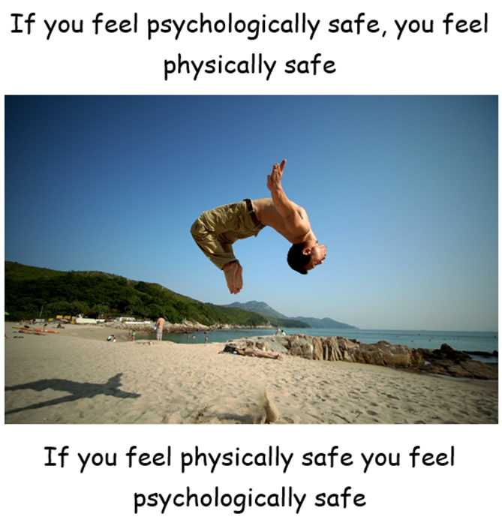
Creating a Safer Environment
Conduct a violence assessment of your location(s)
Education and training
  Identifying warning signs of violence
Review working alone and isolation procedures
Openly communicating with staff
Employee and Family Assistance Plan
Having a system in place to debrief after an incident
Notes:
Jess
In conducing a violence assessments: this engages a proactive effort to identify the areas of vulnerability, and the opportunity to implement corrective actions as a preventative measure
Education and training is addition to creating a safer environment. By providing the tools and knowledge to protect oneself we are giving our workers autonomy to have control in an area that might have not felt controlled
Working alone or in isolation, revieing the procedures and utilizing the results of the violence assessment to identify areas of exposure and ensuring that staff is prepared and understands the process of calling for help or not leaving themselves open to violent responses
Developing a relationship with staff in which open communication is well received allows the opportunity for staff to bring concerns forward, identifying changes in client behavior, responsive tendencies ect
EFAP is there in the event of a traumatic incident or sometimes the day-to-day tole of working with people are starting to chip away at our stability. Having and EAP program shows you care, you have supports in place and reminding staff via open communication is going to allow our workers to take the opportunity to take care of themselves because
While a single debrief after an incident may not decrease the instances of PTSD, it will open the door for the opportunity to engage further treatment, connecting victims with services that can assist with post traumatic events.
It shows the workers that the employer does care bout their physical and mental health and allows for an opportunity for self care with the support of the employer
If we aren't taking care of ourselves, can we actually take care of our clients????
Last point,
While a single debrief after an incident may not decrease the instances of PTSD, it will open the door for the opportunity to engage further treatment, connecting victims with services that can assist with post traumatic events.
It shows the workers that the employer does care bout their physical and mental health and allows for an opportunity for self

Slide 15
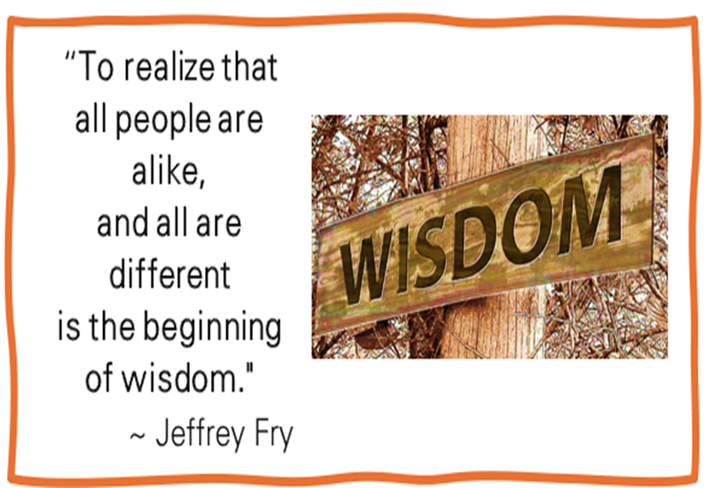
Recognizing and Overcoming Societal Barriers
What if we asked the opposite question?
Not how are we all different, but how are we alike?
Notes:
Jess
We all want to be respected and treated with dignity, regardless of the situation.
Once we recognize there are barriers in society we have put up, inadvertently or by design, we can begin to remove them
Ultimately, we all want to belong, be engaged and be valued, recognizing that similarity opens up the door to engage
When we ask this question, we are breaking societal barriers – we stop looking at the differences between what we are accustomed to, and start looking at the individual on a personal level – as a person, we want to be respected, we want to be told what’s happening to us before it happens, etc. so when we change the way we look at the situation, we change the way that we respond to the individual by becoming more compassionate and empathizing with them.

Slide 16
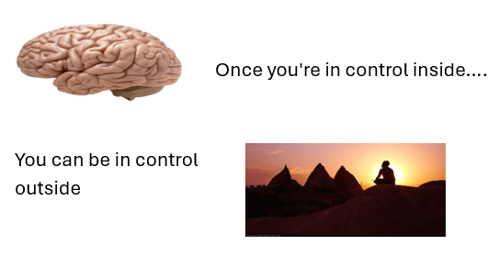
Managing Personal Responses
Maintain professionalism
Know your triggers
Our greatest weakness can be our greatest strength
Notes:
Jess
When we define our weaknesses, we bring them out and make them part of our consciousness. We admit them, bringing them to the light of recognition. We can name only that which we own, so when we name them, we acknowledge that we have taken ownership of them
No matter what is said, you’re going to deflect the abuse, not take it personally, remain professional, and keep your eyes on the purpose.
There are always two kinds of problems in any difficult encounter: your problem, as you define it as a professional, and the problem from the other person’s point of view (the rhetorical problem: how the other person sees it). The only way to succeed in these situations is to define the problem from the other person’s point of view first.
Everyone has preconceived notions, recognizing the negative ones and redefining the concept will also help with managing our personal responses
Changing the inner dialogue from the negative inner voices to a more positive outcome

Slide 17

Managing personal response
In Latin means “to give back”
Notes:
Jess
RE spect
We have to show people at all times
Thought it might be difficult when our residents are exhibiting challenging behaviors on a regular basis….
Check our approach
Keep in mind, we all would rather:
be asked than told what to do
Know why they are being asked/told to do something (not telling why is a sign of disrespect and lowers morale in all organizations)
Have options rather than threats (Offering people a choice of action shows respect and allows people to save personal face.) (remember our residents have lost a lot, they have lost independence, some anonymity, often independent individuals are slowly becoming more dependent….this is hard, and discouraging….and may bring on feelings of frustration and some anger)
A second chance to make things right
We understand we don’t always agree with their actions, but we need to respect them
When we treat them on a human level we are looking at them as living, breathing, feeling people and not just a difficult behavior
RE in latin means to give back: we give them the empathy we would want to receive in this situation
We always want to treat people how we would want to be treated under identical or similar circumstance

Slide 18

Violent Behavior Response Training
Fit for Duty
Identifying responsive behaviours
Practical approaches and intervention strategies
Notes:
Teaghan
Introductory slide, just list off the topics as we are going to cover them in the next few slides

Slide 19
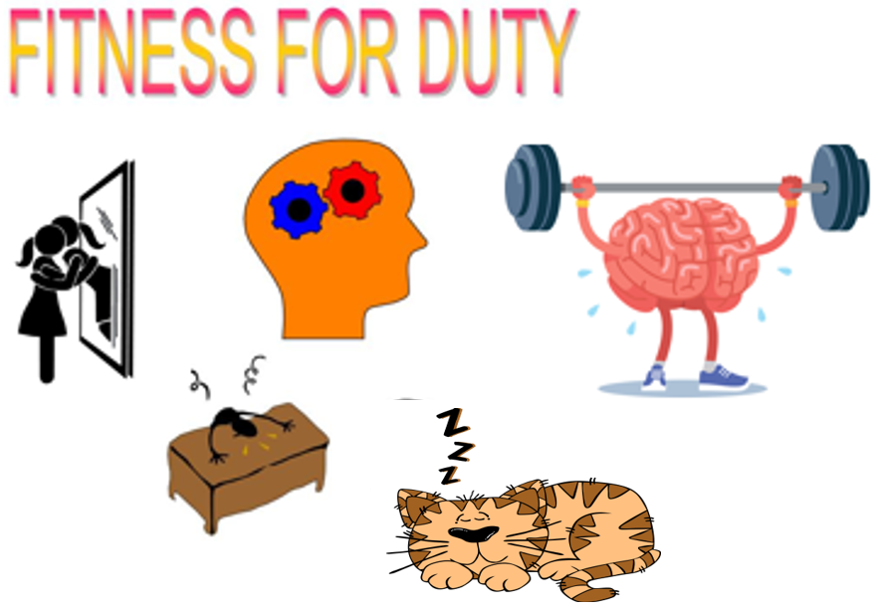
Notes:
Teaghan
Are you emotionally, physically, physiologically mentally prepared for your day?
Have you had enough sleep?
Are you wearing clothing appropriate for completing your tasks?
Is your hair pulled back?
Are you wearing any jewelry that may be grabbed? Is the jewelry sentimental? How would you feel if it was broken
Do you take time to look after yourself outside of work? What are you doing for your mental health –i.e.) leaving work at work and filling your cup between shifts.
How are you ensuring you remain fit for duty while at work?(micro breaks, staff interactions, incident debrief)
Fit for duty doesn’t just mean are you’re physically fit, it also encompasses the psychological aspect of our health such as, getting adequate sleep, being mentally prepared, and taking care of yourself

Slide 20

Identifying Responsive Behaviors
Physical Signs
Body Language
Positive Changes
Negative Changes
Triggers
Notes:
Teaghan
Physically what are they doing
Are they shaking, red in the face, are they entering your space, voice getting louder, clenching fists, pacing, frowning, glaring or suddenly quiet
Tightening jaw, stomping, or making sudden jerking movements
When we talk about identifying responsive behaviors, we don’t always mean the most obvious things.
Though we are able to physically see changes in their body language such as shaking, their face turning red, encroaching our space, or making themselves appear bigger than us,
But we’re also talking about what we hear; their voice getting louder, they're breathing heavier/louder, they’re sighing more frequently,
Also what is their silent body language? Are they more focused on us? Are they focusing on the room or something around us? Are they scanning for an object? Etc.
Notice “positive” and “negative” changes in behaviors
Notice any triggers that cause changes in behavior

Slide 21


Practical Approaches and Intervention Strategies
Identifying Responsive Behavior
Intervention Strategies:
  Escalation
  Crisis
  Recovery
Assertive Communication
Rule of 5
Notes:
Teaghan
De-escalation, communication, give space,
Empathy and understanding come into play
Discuss PART
When we move into the intervention stage, it is important to highlight that we MUST maintain self-control. If we aren’t in control of ourselves, we will be less likely to assist an individual in de-escalating.
Talking an individual into stopping the behaviour is most often the most appropriate approach.
When we’re talking to an escalated individual, it’s important that we use simple, brief and direct language.
We must remain assertive and direct. (firm in our boundaries)
Avoid using excessive words (rule of five: 5 words or less per sentence, 5 letters or less per word)
We also need to consider the timing of our intervention – shortly before (during escalation), during (crisis), and shortly after (recovery), will be the best times to verbally intervene.
Not all situations require us to verbally intervene. Always remember that the episode will pass. Do not keep pursuing conversation if its is not effective. Have patience for the behaviour and the individual.
Maintain self-control – if you start becoming agitated or annoyed, this will translate as frustration to the individual and could potentially cause further escalation
ALWAYS BE READY TO MOVE – the individual may be spontaneous – they may make sudden moves or change their behaviour quickly. It’s important that we are prepared to move out of the way (if physical), or adapt to the situation and move with them! (be flexible and think on our feet)
Triggering phase:
Focus on self control, briefly state expectations (consistent with treatment/care plan)
Diversion and distraction
Escalation:
Verbal crisis communication
Simple, direct, brief communication
Communication should match motive (fear, frustration, manipulation, intimidation)
Crisis:
Verbal crisis communication
Evasion or restraint (within reasonable force guidelines)
Recovery:
Verbal crisis communication
DO NOT DISCUSS CONSEQUENCES
Self-isolation of individual may happen here
Post crisis depression:
Active listening
Unconditional positive regard
NO CONSEQUENCES OR BLAMING
Determine the source of the crisis
Allow individual to freely express their feelings
Close supervision (suicide/escape)
Return to treatment/care plan after this phase.

Slide 22
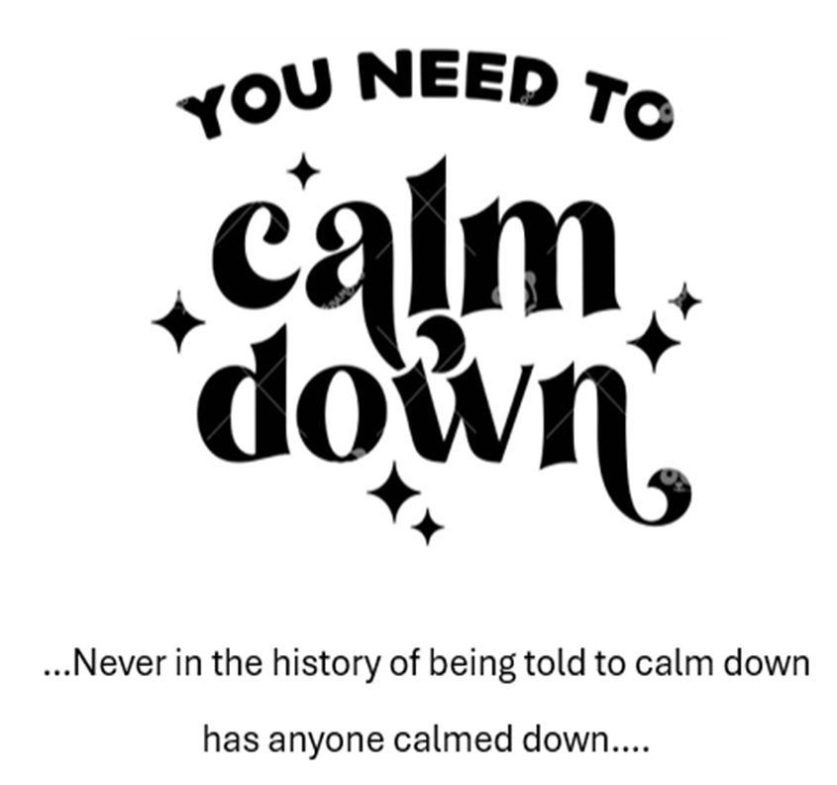
P.A.R.T
How MASH has adopted the PART program:
  Goals
  Tools
  Empathize
Notes:
Teaghan
GOAL: to identify, assess, intervene (if necessary) to bring the individual back to baseline
In construction, workers have physical tools to help them. In healthcare? We are our best tool!
When we understand the behaviour the individual is displaying, and understand that it is not a direct reflection of us (don’t internalize it), we can then empathize with the individual and de-escalate the situation
At MASH, we have adopted the PART program (Professional Assault Response Training) from SASWH (Saskatchewan Association for Safe Workplaces in Health). This training program teaches how to identify responsive behavior, the importance of maintaining self-control and professionalism, how to appropriately identify what approach is best to use with responsive behaviors, the importance of assertive communication, and includes physical intervention methods such as evading and deflecting aggressive behavior, as well as restraining individuals as necessary.

Slide 23

Understanding violence prevention
Psychological health and the importance in long term care settings
P.A.R.T training
Notes:
Teaghan
Understanding Violence prevention and the importance and positive effects it can have on health care workers
Psychological health and the importance in long term care settings….if you don’t feel psychologically safe how will you feel physically safe and without physical safety, do we have psychological safety
Responsive behavior response training/PART
Adopting a training program to help identify responsive behaviors would highly benefit all workers in identifying responsive behaviors, impending sings of aggression or escalated behaviour and educate on the response techniques as well as safe, tested methods to physically intervene at the appropriate interval to ensure safety to both staff and the individual
PART
Consists of 9 models that can help identify the source of behavior as well as appropriate responses for each model. It walks through the stress cycle and instills confidence in workers by utilizing tested and successful methods of intervention.

Slide 24

Notes:
Jess
in summary, when we look at the importance and benefit of a violence prevention and promoting a psychological program
What is the outcome, who will it impact? there are so many ways we can implement and encourage
We’d like to share a story on the benefits of change.

Slide 25
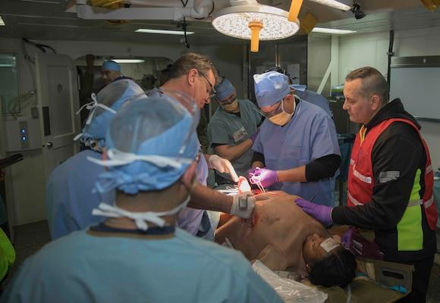
For more information on P.A.R.T reach out to MASH at
hello@mashmb.ca

